Slide 1
LiBaaS Embedded System Load
Date: 08-03-2021

Slide 2


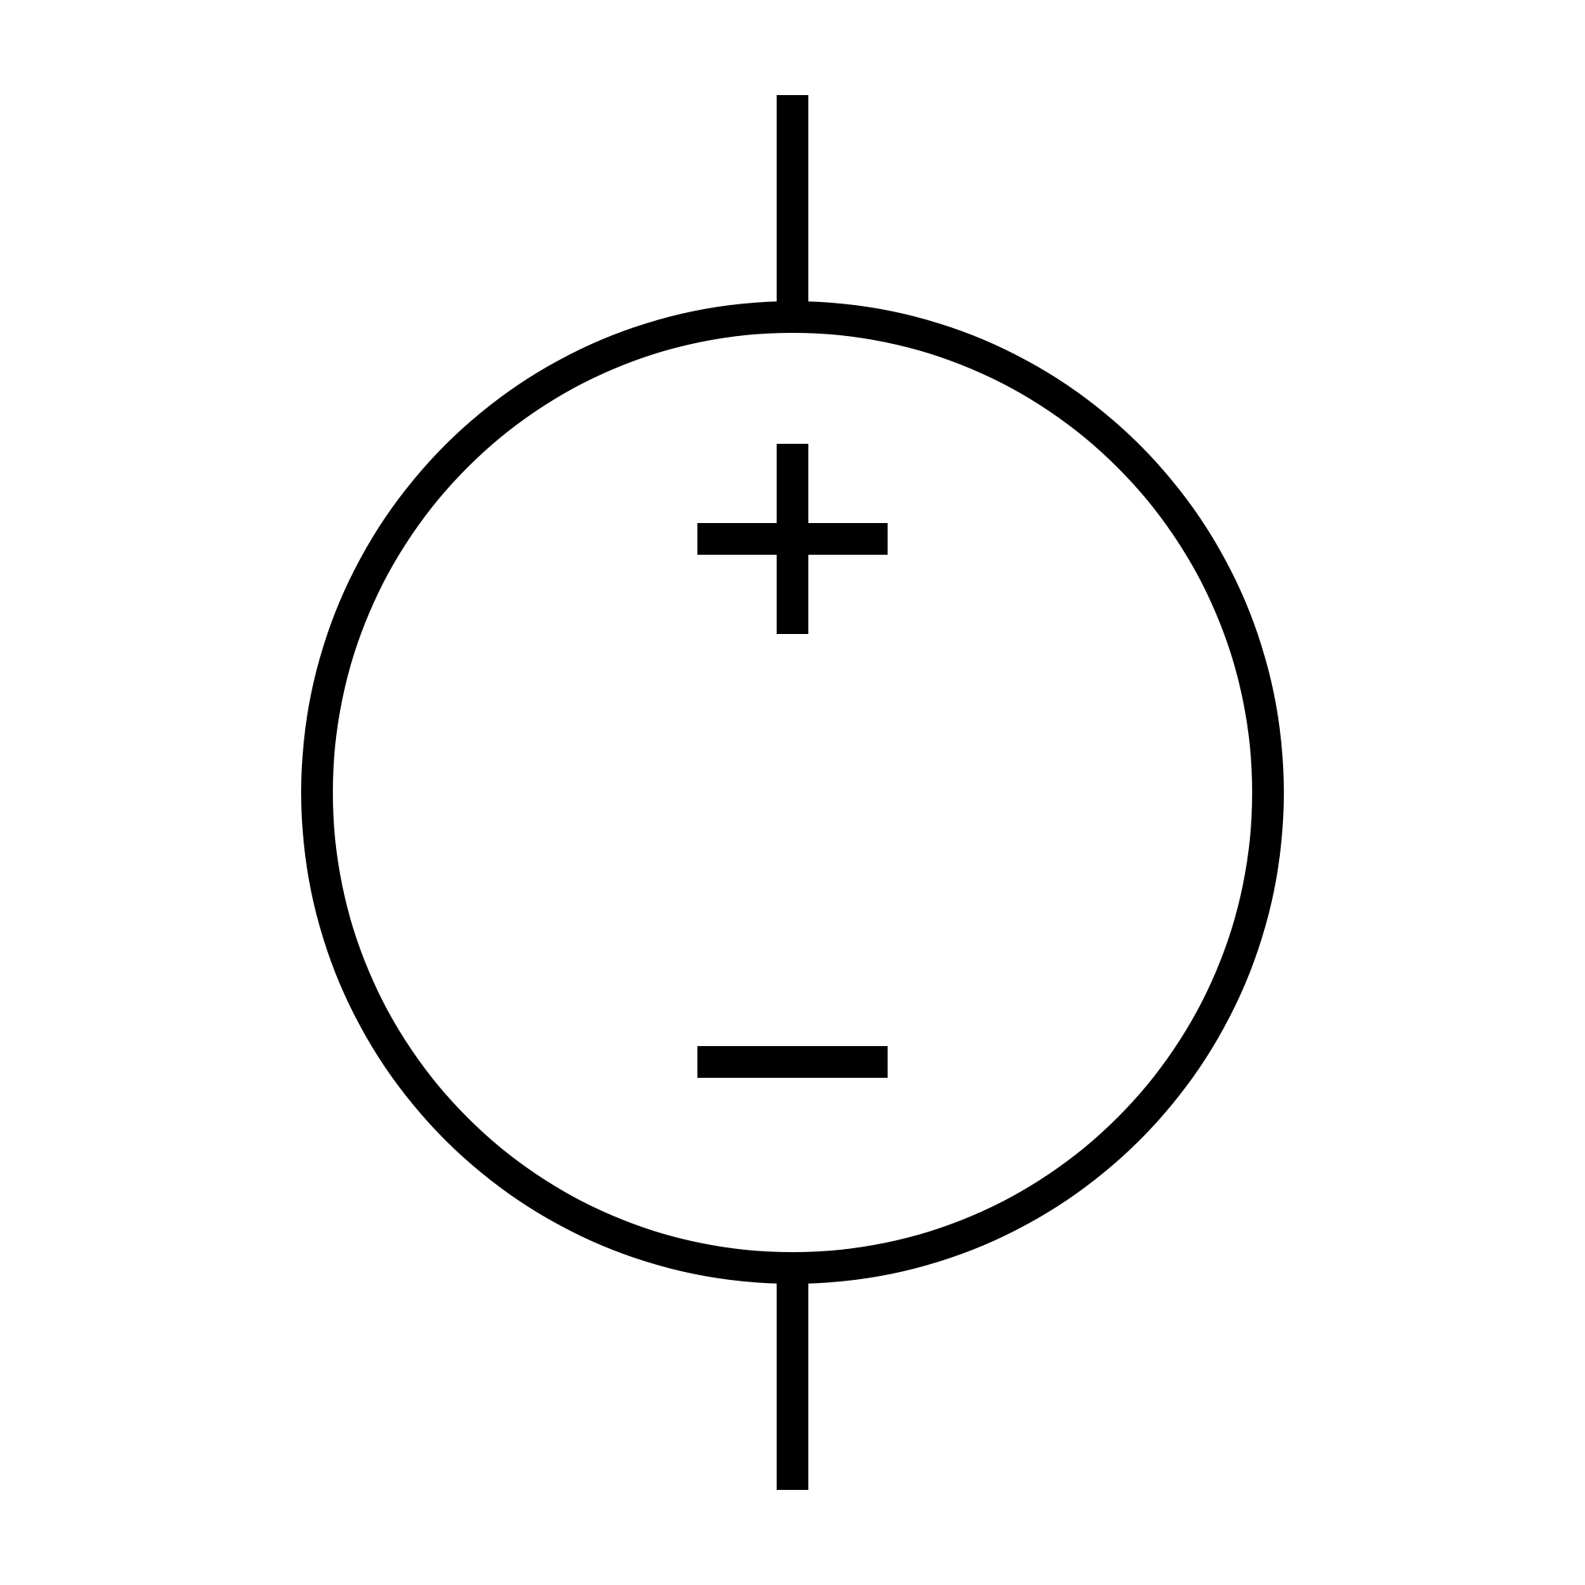
Load Diagram
12V 1A
12V 1A
12V 1A
12V 1A
Battery
pack

